Slide 1
TRANSP physics and application to JET plasmas
I. Voitsekhovitch
Acknowledgements:
D. McCune, R. Andre, R. Budny, J. Conboy, M. Gorelenkova, S. Kay
TRANSP training session, 24-27 November 2014

Slide 2
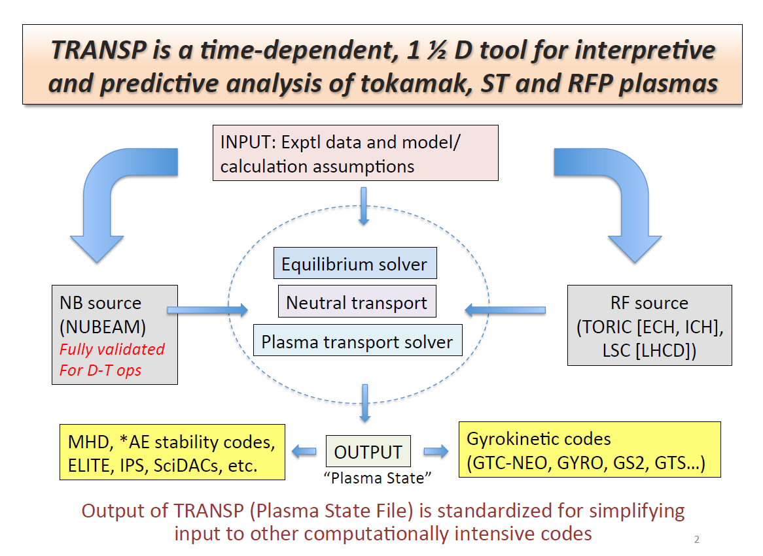
S. Kay, JET-PPPL remote meeting 20/09/2013

Slide 3
TRANSP documentation
User guide to select the physics modules and options is available, but no manual describing physics
Information on TRANSP physics presented here comes from publications and discussions with TRANSP team during last 10 years
This talk includes physics description when available and the options for physics modules in TRANSP
Ref. to TRANSP: R. J. Goldston et al., J. Comput. Phys. 43, 61 (1981). Refs. to TRANSP modules on JET/TRANSP and NTCC pages

Slide 4
Outline
Equilibrium (see also talk by Hyun-Tae Kim)
Diagnostics simulations and data consistency: will be addressed later on
Poloidal field diffusion
Auxiliary heating
Edge particle source
MHD: sawtooth model
Predictive TRANSP

Slide 5

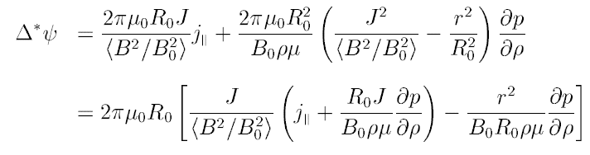
Grad-Shafranov equation
or
No explicit time dependence: plasma is always in equilibrium, fast relaxation process with respect to transport
Coupled to time-dependent transport equations in predictive part of code

Slide 6
Equilibrium modules: VMEC
VMEC = Variational Moments Equilibrium Code (S. Hirshman, ORNL)
the full 3D MHD equilibrium equations for arbitrary geometry
truncated to a 2D code suitable for modeling tokamak geometries of arbitrary moment and adapted it to TRANSP:
1. fixed boundary: the plasma boundary prescribed by a set of Fourier coefficients in R and Z
2. other input parameters:
a) enclosed toroidal flux
b) pressure profile
c) profile μ = ∂ψ/∂Φ
3. can handle pressure anisotropies IN PRINCIPLE. The version currently in TRANSP, however, is purely isotropic
4. Φ_{tot} is used as an initial guess in arriving at a solution that conserves Ip, by varying Φ_{tot}
References:
S.P.Hirshman and J.C.Whitson, PHYS.FLUIDS 26, 3553 (1983).
S.P.Hirshman and H.K.Meier, PHYS.FLUIDS 28, 1387 (1985).
S.P.Hirshman and D.K.Lee, COMP.PHYS.COMM. 39, 161 (1986).

Slide 7
Equilibrium modules: TEQ
MHD equilibrium code used in the Corsica transport code (LLNL)
Fixed boundary solution using the pressure and q profiles as input
The vacuum R*Btor is used as a boundary condition
After the initial startup, TEQ is called in a loop which adjusts the q profile near the edge region in order to match to the total plasma current
Radial grid: uniform or stretched near the axis or the edge

Slide 8
Outline
Equilibrium (see also talk by Hyun-Tae Kim)
Diagnostics simulations and data consistency: will be addressed later on
Poloidal field diffusion
Auxiliary heating
Edge particle source
MHD: sawtooth model
Predictive TRANSP

Slide 9
Options for current profile evolution
Prescribed q-profile, q(time, r)
Evolve the q profile using input data: Bpol/Btor vs (R,t) or θ vs (R,t) where tan(θ)=Bpol/Btor
Poloidal field diffusion equation (PFDE) can be used to estimate the resistivity profile in these two cases, but non-physical negative values of resistivity can come out (it depends on the quality of the q profile data, dq/dt, etc)
Solve poloidal field diffusion equation
It is possible to switch back and forth amongst these options in the course of a run.

Slide 10


Poloidal field diffusion equation (PFDE)

Slide 11
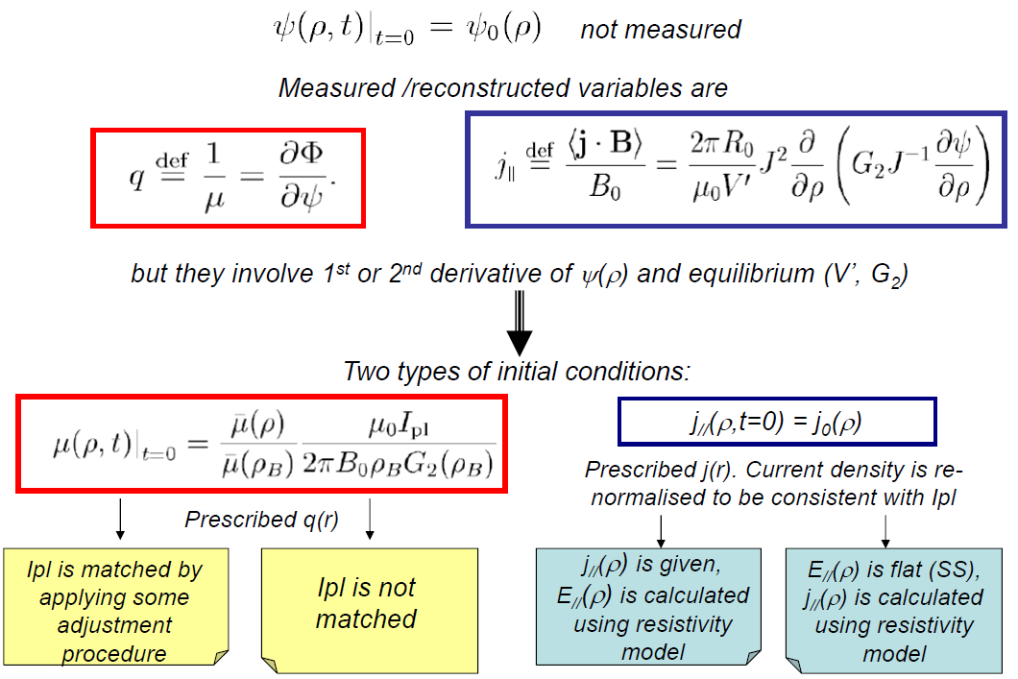
Initial condition for PFDE

Slide 12
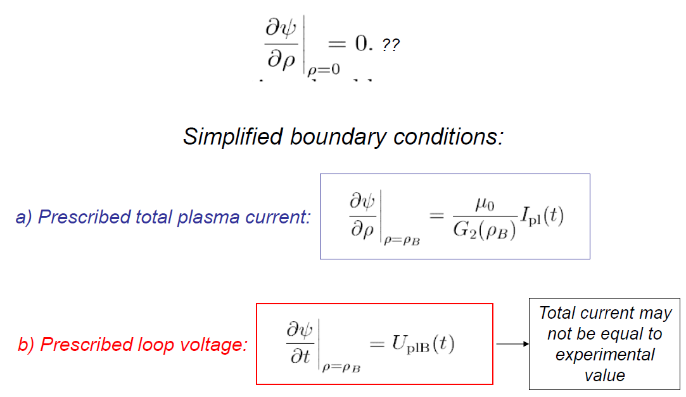
Boundary conditions for PFDE
may be inconsistent with total plasma current

Slide 13
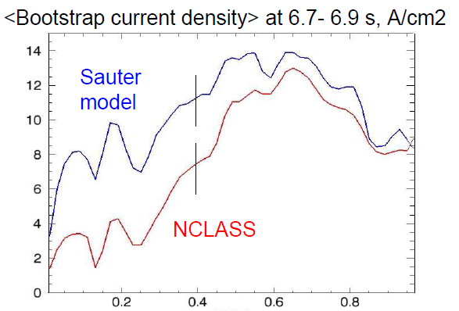
Modules for resistivity and bootstrap current
Spitzer resistivity
Analytical neoclassical models (S. P. Hirshman, et al Nucl. Fusion 1977; TSC model)
NCLASS (full multi-species representation of plasma profiles, valid for arbitrary geometry and collisionality regimes) [W. A. Houlberg et al, Phys. Plasmas 1997]
Sauter model (analytical expressions fitting the code simulations: Fokker–Planck equation with full collision operator, arbitrary equilibrium and collisionality regimes) [O. Sauter and C. Angioni, PoP 1999]
#68875
ρ
Ibs, simulated q, NCLASS | 0.36 MA
Ibs, simulated q, Sauter model | 0.43 MA
Ibs, EFIT/q, NCLASS | 0.4 MA
Ibs, EFIT/q, Sauter model | 0.5 MA

Slide 14
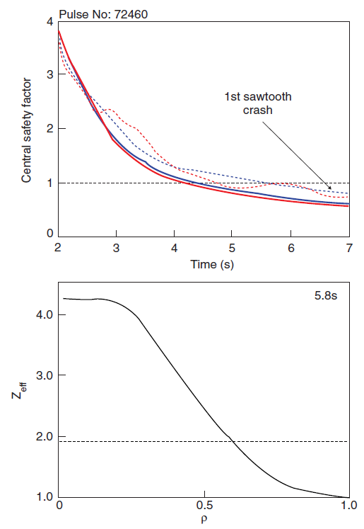
Current diffusion studies for JET: OH current ramp up
Voitsekhovitch et al, PPCF 2010
Simulations of current diffusion with measured T_{e} and line averaged Z_{eff}
EFIT/Q is initial profile
First sawtooth crash (i.e. q₀ > 0.8) at 6.9 s
Flat Zeff (red): ECE Te (solid), LIDR Te (dashed)
Peaked Zeff, ECE Te (blue dashed)
σ ∼ T_{e}^{3/2} / Z_{eff}
Sensitivity to Z_{eff} profile:
flat Z_{eff} → slower current diffusion towards the centre, higher q₀ at the beginning of the ramp up
peaked Z_{eff} → broader stationary j, higher q₀
Sensitivity to T_{e} profile:
peaked T_{e} →slower current diffusion towards the centre, higher q₀ at the beginning of the ramp up
flat T_{e} → broader stationary j, higher q₀

Slide 15
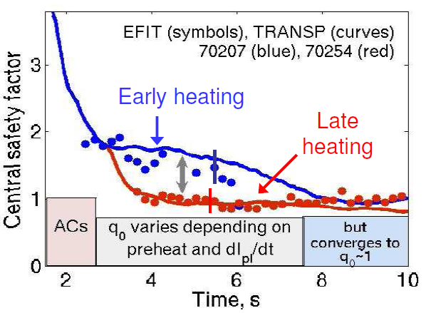
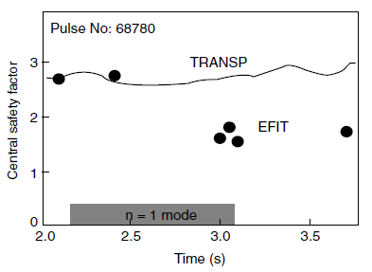
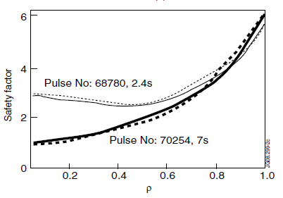
Current diffusion studies for JET: high β_{N} scenario
Current diffusion simulations with measured Te, Zeff. NCLASS is used
EFIT/Q is initial profile taken 0.5 s before the NBI start
Good agreement with EFIT for discharges with early and late NBI start
Over-estimated central q in discharge with strong n=1 mode
Voitsekhovitch et al, Nucl. Fusion 2009

Slide 16
Outline
Equilibrium (see also talk by Hyun-Tae Kim)
Diagnostics simulations and data consistency: will be addressed later on
Poloidal field diffusion
Auxiliary heating
Edge particle source
MHD: sawtooth model
Predictive TRANSP

Slide 17
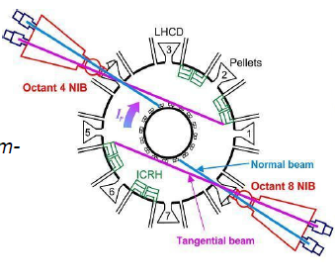
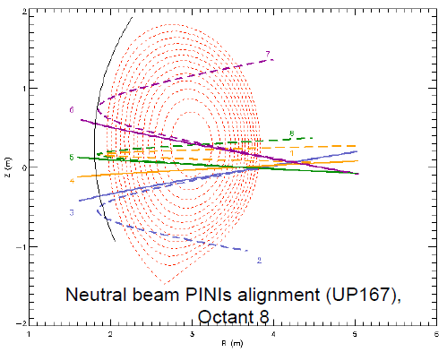
Neutral beam injection: NUBEAM [A.Pankin, CPC]
2D code, realistic geometry
Monte-Carlo technique for beam ions and fusion products
FLR effects included
Deposition, secondary CX, slowing down
Orbit losses, collisional and anomalous diffusion
Sawtooth mixing of fast ions
Built into JET database
Frequently used output:
heat, particle and momentum source
Fast particle distribution function f(ρ, pol.angle, E, pitch angle)

Slide 18
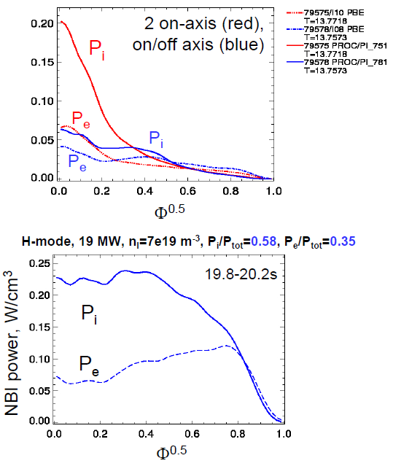
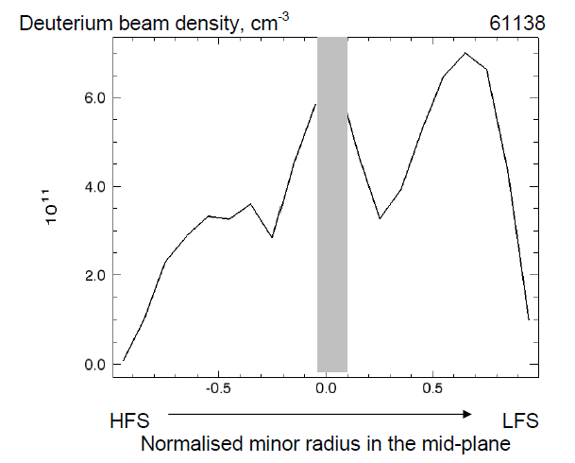
Examples of NUBEAM simulations for JET
NBI heating profile obtained with different beam configuration and plasma density
Voitsekhovitch et al, Nucl. Fusion 2007
L-mode, 3 MW
Deuterium beam density profile in high density H-mode plasmas, obtained by integrating the 4D distribution function

Slide 19
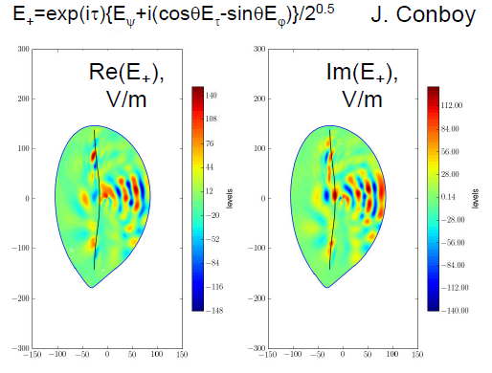
Ion Cyclotron Heating: TORIC
FLR full wave code
Solves Maxwell’s equations in presence of plasma and wave antenna
Retains the 2nd harmonic wave frequency
specify both the damping power density on minority fast ions, and the 2D wave field (E+, polarization, k⊥, k_{ll})
Combined with FP module FPPMOD: re-normalises the original QL operator zone by zone while keeping the total power constant
Application for:
minority heating (H and He3)
fundamental D heating
mode conversion
Refs: M. Brambilla, PPCF 41, 1, (1999) & M. Brambilla and T. Krucken, NF 28, 1813 (1988); D. G. Swanson, Phys. Fluids 24, 2035 (1981); P. T. Colestock and R. J. Kashuba, NF 23 763 (1983); J. C. Wright et al, PoP 11, 2473 (2004)

Slide 20
Lower hybrid heating and current drive
LSC (D.W.Ignat, E.J.Valeo):
multiple ray tracing in general non-circular axisymmetric plasmas specified by a numerical equilibrium
solve at each of several flux surfaces a simple one-dimensional (in velocity) Fokker Planck equation for the quasilinear evolution of the electron distribution function
provide the RF power and RF-driven current electric field
Refs: D. W. Ignat, Phys. Fluids, 1981; E. J. Valeo and D. C. Eder, J. Comp. Physics, 1987. C. F. F. Karney and N. J. Fisch, Phys. Fluids 1986
GENRAY (work in progress):
- ray tracing code
- can be used for modeling electron cyclotron and lower hybrid heating and current drive in tokamaks

Slide 21
Outline
Equilibrium (see also talk by Hyun-Tae Kim)
Diagnostics simulations and data consistency: will be addressed later on
Poloidal field diffusion
Auxiliary heating
Edge particle source
MHD: sawtooth model
Predictive TRANSP

Slide 22
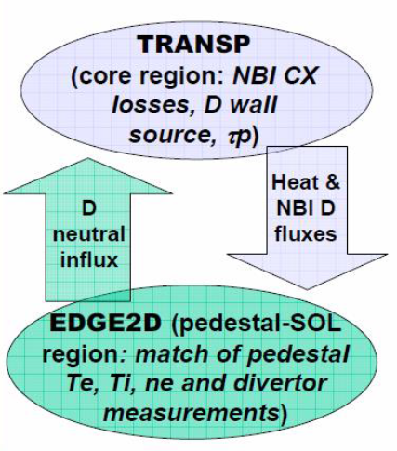
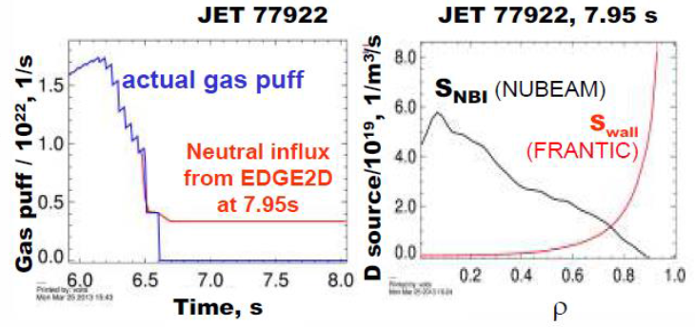
FRANTIC [Korotkov A.A., Zinove’v A.N, Sov. J. Plasma Phys. 1989]
Fluid 1.5D model, no poloidal variation of the source
Simplified geometry: nested cylinders of shifted centers given by flux surfaces
Multiple ion and neutral species
Charge exchange, impact ionization
Input: neutral flux and energy of incoming neutrals (multiple energy species)
For JET simulations: gas puff and re-normalised Dα signal, Γneut = Γpuff + const*Γα
Wall particle source Γneut is ad hoc, should not be used for estimation of global particle confinement
TRANSP-EDGE2D estimation of wall particle source for JET plasmas started under ITM/ISM (collaboration with Paula Belo)
TRANS-EDGE2D iterations (more detailed description in Voitsekhovitch et al NF 2013)
Estimation of particle confinement time and Γα
normalisation [Voitsekhovitch et al EPS 2012:
79635 (low power HS): τp=0.4 s, τE=0.16 s, const=17.5
77922 (high power HS): τp=0.54 s, τE=0.25 s, const=16.8

Slide 23
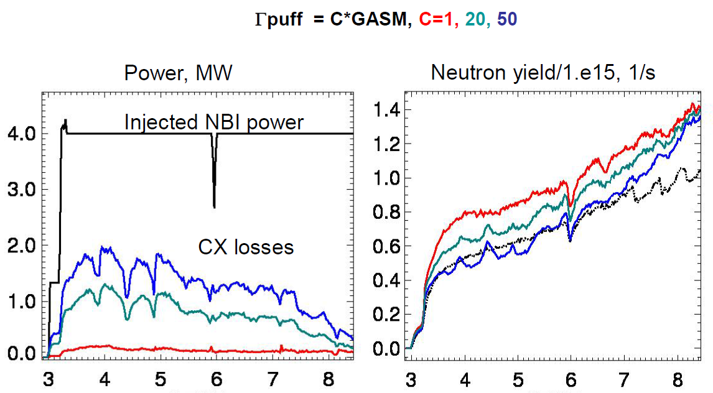
Effect of gas puff (CX losses) on neutron yield during current ramp up
Time, s
Time, s
sensitivity to CX losses is tested by varying gas puff
good agreement with measured neutron yield with C ~ 40, but the CX losses are high

Slide 24
Outline
Equilibrium (see also talk by Hyun-Tae Kim)
Diagnostics simulations and data consistency: will be addressed later on
Poloidal field diffusion
Auxiliary heating
Edge particle source
MHD: sawtooth model
Predictive TRANSP

Slide 25
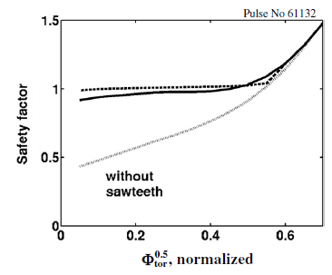
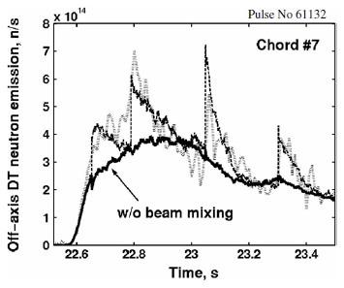
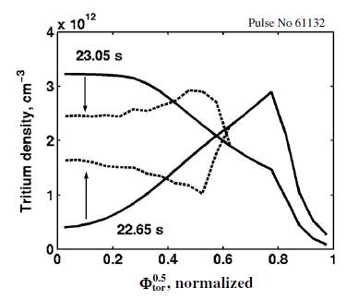
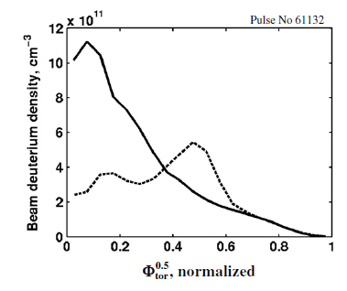
Kadomtsev reconnection model [Sov. J. Plasma Phys., 1975]
TRANSP sawtooth models:
crash times taken from data (ECE, soft X-ray)
radius with q=1 is extended to provide the helical flux conservation
q, Te, Ti, thermal and fast ion (NBI & RF) densities are mixed following the reconnection of magnetic flux surfaces:
→ centrally peaked profiles flatten
→ off-axis particles go towards the center
Voitsekhovitch et al, PPCF 2005

Slide 26
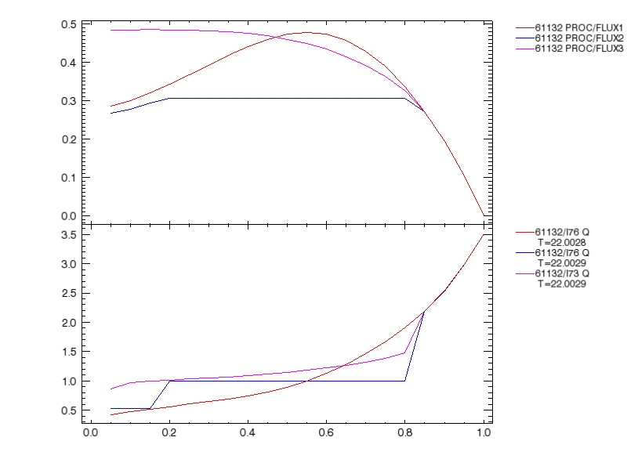
Porcelli reconnection model [PPCF, 1996]
Kadomtsev mixing yields q>=1 everywhere; Porcelli mixing generally leaves a region with q<1 near the axis
Options in Porcelli model:
- two mixing regions: "island" around q=1 and axial region inside the island annulus
- single mixing region for predicted plasma species, covering both the q=1 island and the axial region
- island width controlled by user
- fraction of mixed fast ions controlled by user
Evolution of q-profile during the first sawtooth crash in Kadomtsev (red and pink) and Porcelli (red and blue) models (same initial conditions)
Safety factor
ρ

Slide 27
Outline
Equilibrium (see also talk by Hyun-Tae Kim)
Diagnostics simulations and data consistency: will be addressed later on
Poloidal field diffusion
Auxiliary heating
Edge particle source
MHD: sawtooth model
Predictive TRANSP

Slide 28
Predictive TRANSP:
- thermal ion and electron temperature equations
- transport modules for temperature and density
- momentum equation
- modelling of density of trace species

Slide 29
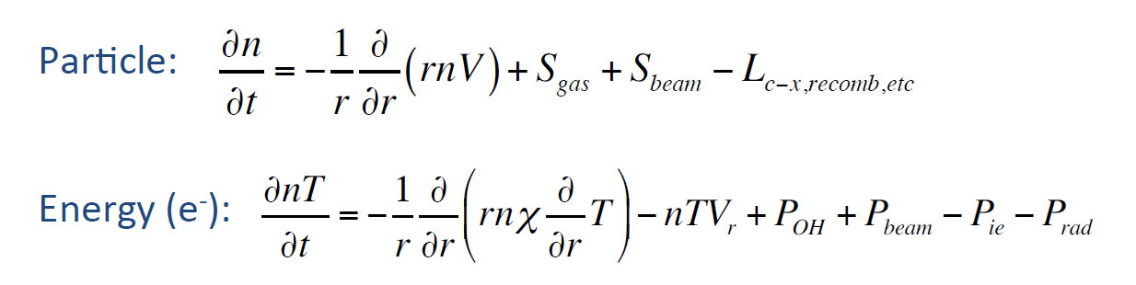
Particle and energy balance equations
S. Kay, JET-PPPL remote meeting 20/09/2013
Whole plasma region or shifted boundary
Source computed with NUBEAM, TORIC, LSC, FRANTIC
Radiative power taken from measurements or computed assuming coronal equilibrium
Transport models: GLF23, Multi-Mode Model, TGLF (not in production version yet)

Slide 30
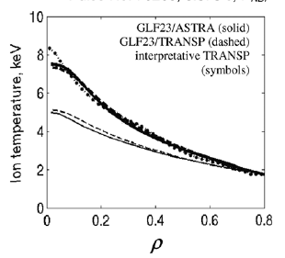
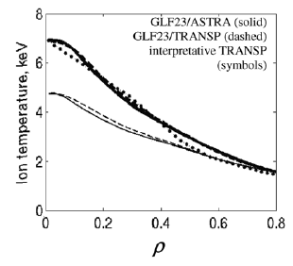
Transport modules: Gyro-Landau-Fluid (GLF23)
[R E Waltz et al Phys. Fluids B 1992 ]
Voitsekhovitch et al NF 2009
- 3D non-linear GLF code (fluctuating n_{i}, P_{i//}, P_{i⊥}, V_{i//}, trapped n_{e} and P_{e}, passing n_{e}, A//, etc., quasineutrality condition + 3D ballooning GKS code
mixing length estimation of transport coefficients:
χ ≈ 1.5(γ_{net} / k_{xM}²) × γ_{d}γ / (γ² + ω²)
ITG, TEM and ETG turbulence, 10 modes in k-spectrum
dependencies: critical gradient, T_{i}/T_{e}, L_{Ti}, L_{Te}, L_{n}, q
implementation: GLF23 coefficients computed self-consistently with Braginskii equations for averaged quantities in time dependent simulations
computes χ_{e}, χ_{i}, D_{i}, χ_{ϕ}
available in NTCC module library: http://w3.pppl.gov/rib/repositories/NTCC/catalog/
Zero ExB shear
#70200, 10 MW
Zero ExB shear
#68875, 19 MW

Slide 31
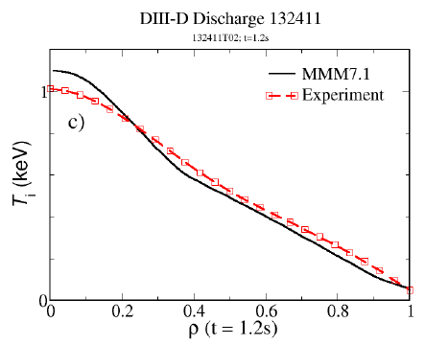
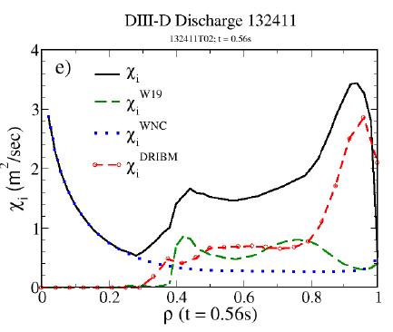
Transport modules: Multi-Mode Model
[G Bateman et al Phys. Plasmas 1998]
$=χ\left(centre\right)+ χ\left(gradient region\right)+ χ(edge)$ + χ_{neocl.}
Kinetic Ballooning Model
Weiland model
Horton ETG model
RBM, DRIBM by T. Rafiq
(L-mode)
NCLASS
paleoclassical
- Flexible implementation: various components can be switched on/off
- Detailed output: χi, χe, χϕ, D for all models, growth rates for Weiland and DRIBM)
T. Rafiq et al, submitted to PoP

Slide 32
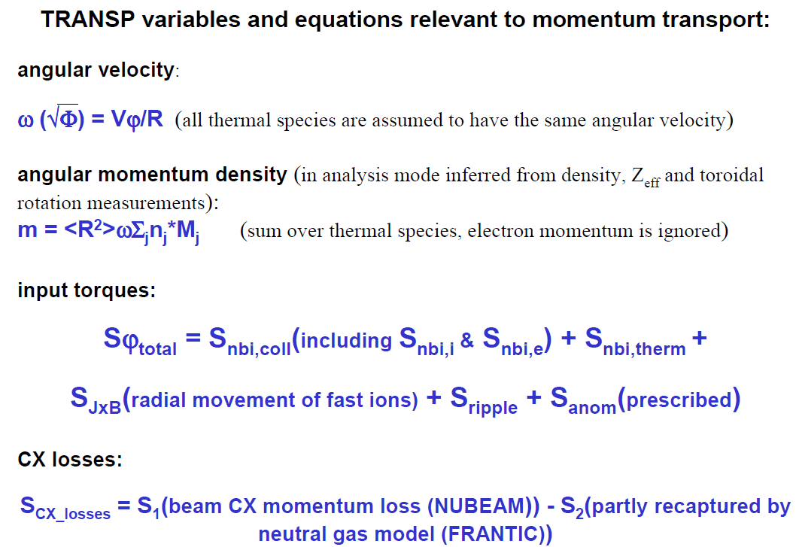
Momentum transport

Slide 33
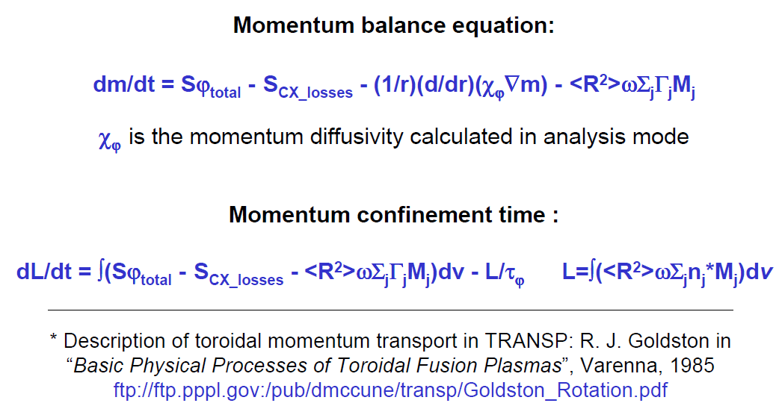
Momentum transport

Slide 34
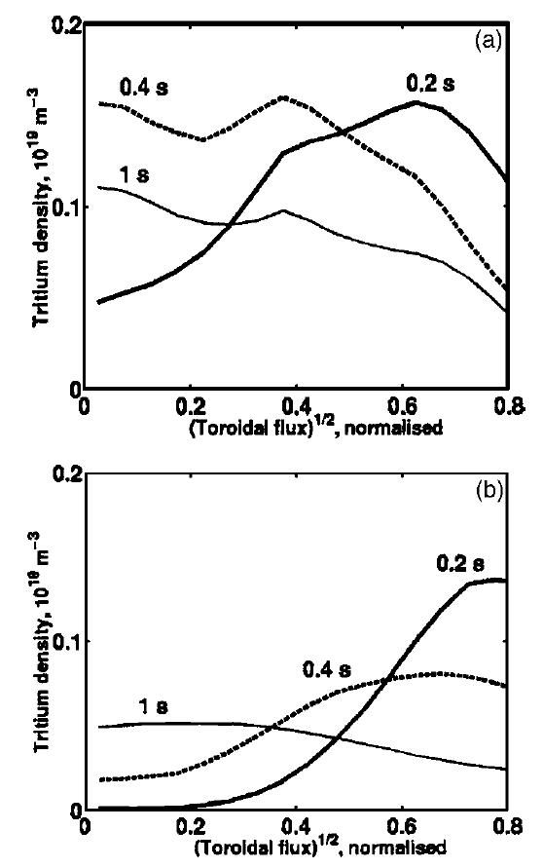
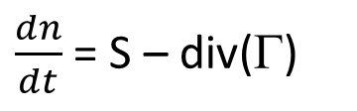


Modelling of trace species
$\frac{dn}{dt}$ = S – div(Γ)
Here S includes beam fuelling, gas flow and recycling
$\text{}$ = V * ( - Lf *grad(n) + n ) (1)
or
$\text{}$ = -D *grad(n) + V *n (2)
JET 61097
V is the non diffusive radial velocity, Lf is the diffusive flow scale length, D is the specie diffusivity (Ufile input).
The following combinations are allowed:
V only -- formula (2), assuming D=0.0
D only -- formula (2), assuming V=0.0
D and V -- formula (2)
Lf and V -- formula (1)
JET 61138
Evolution of trace tritium density after the short tritium gas puff [Voitsekhovitch et al, PoP 2005]

Slide 35
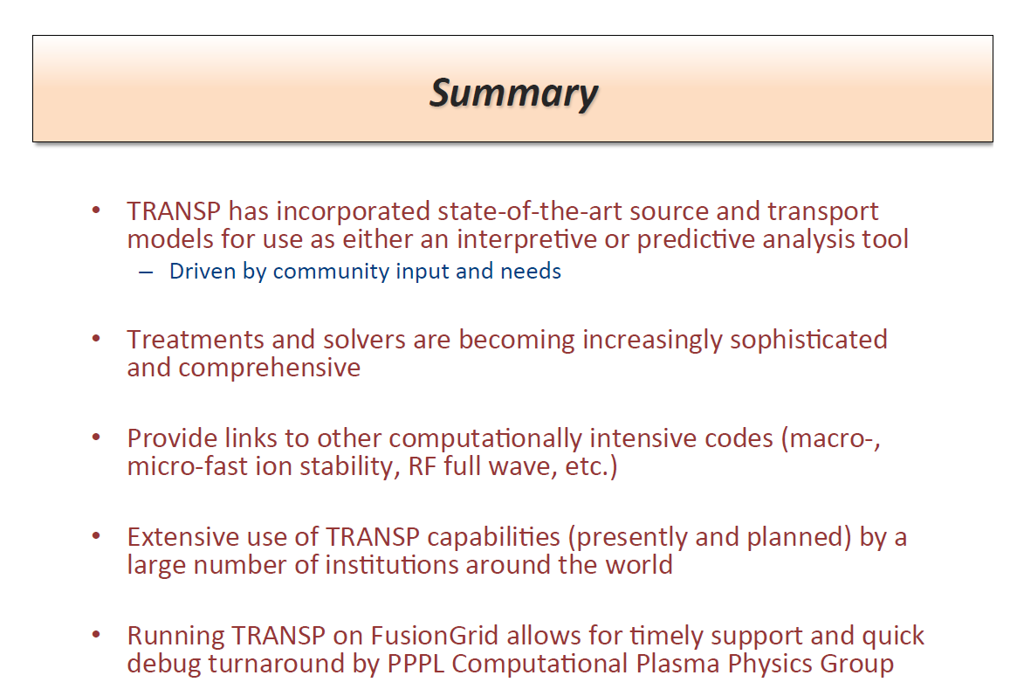
S. Kay, JET-PPPL remote meeting 20/09/2013

Slide 36
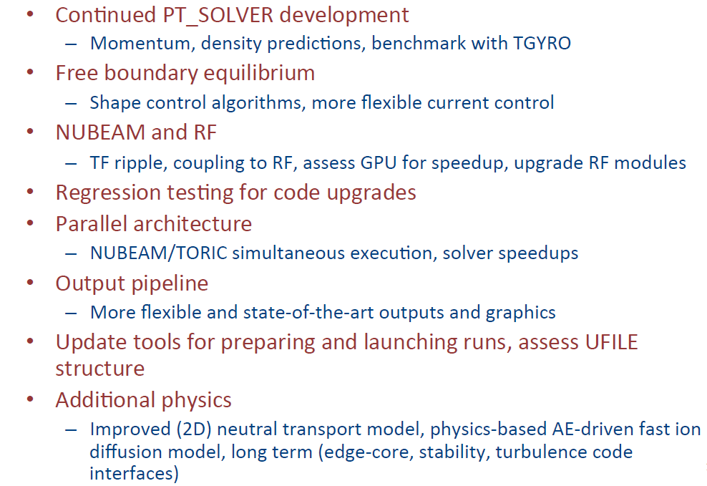
Areas of developments
S. Kay, JET-PPPL remote meeting 20/09/2013

