Slide 1
Transp Course 2014
Overview

Slide 2
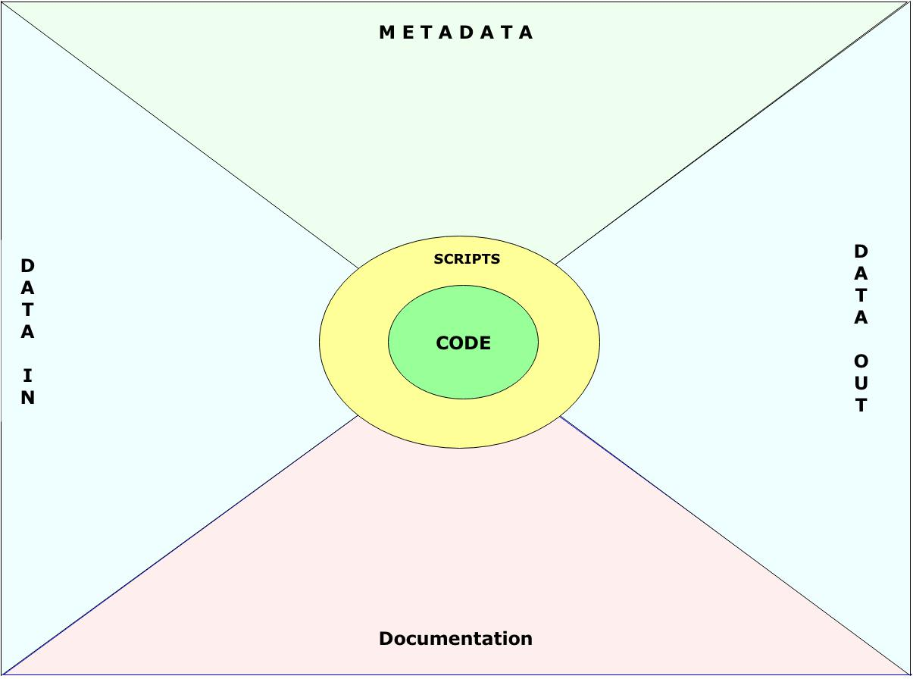
Transp - Environment

Slide 3
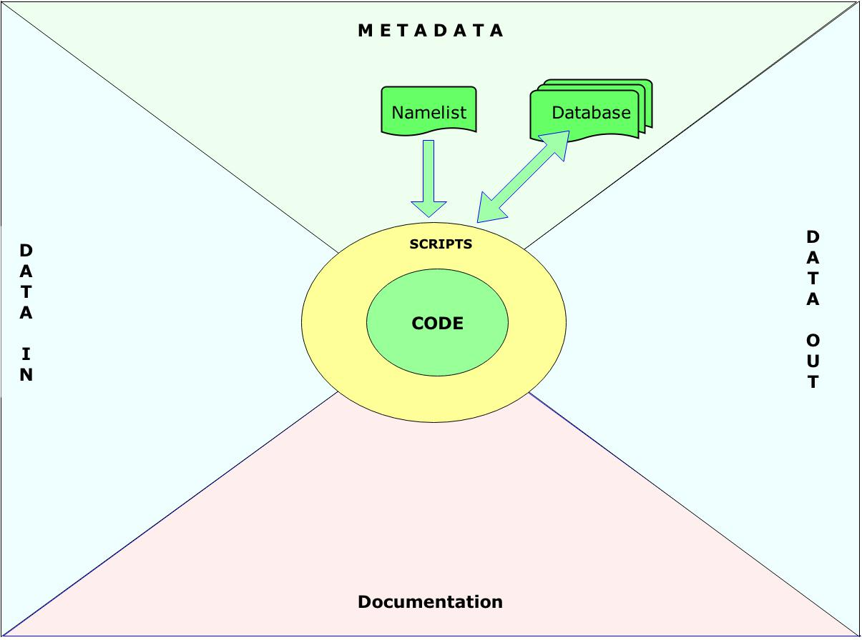
Transp - Environment

Slide 4
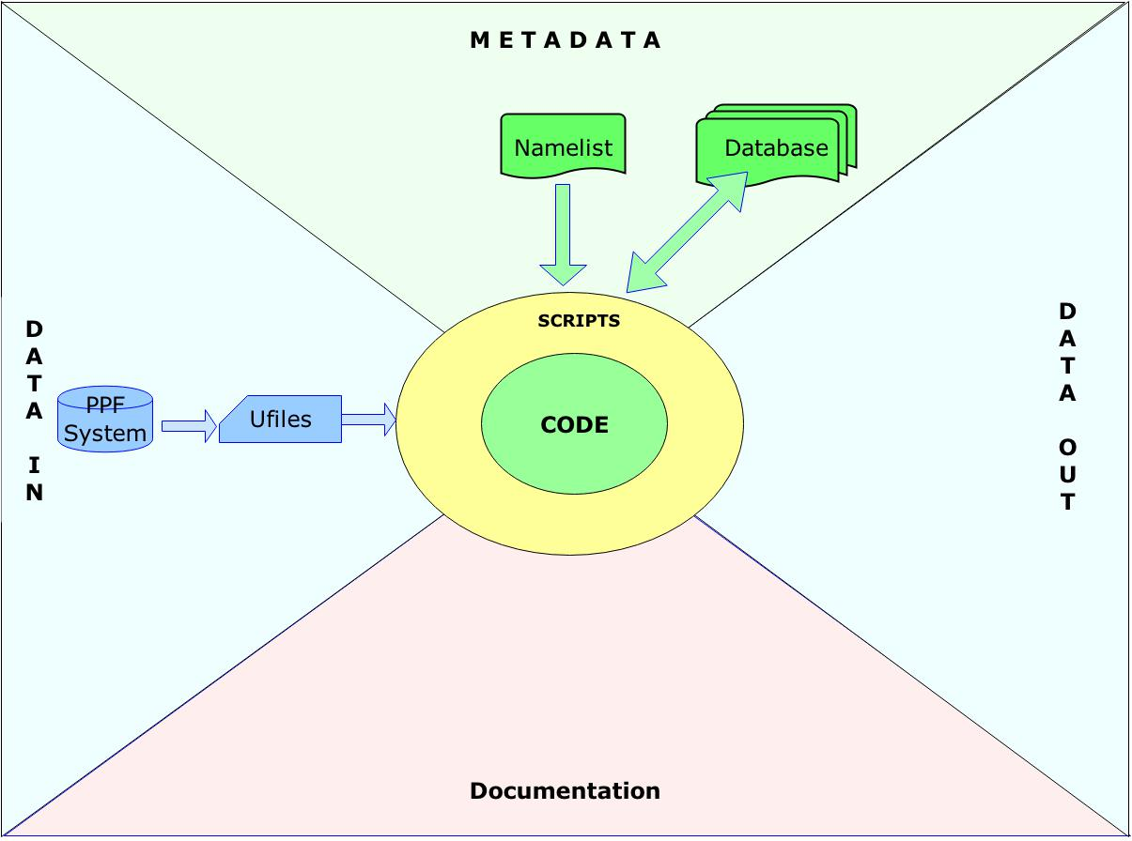
Transp - Environment

Slide 5
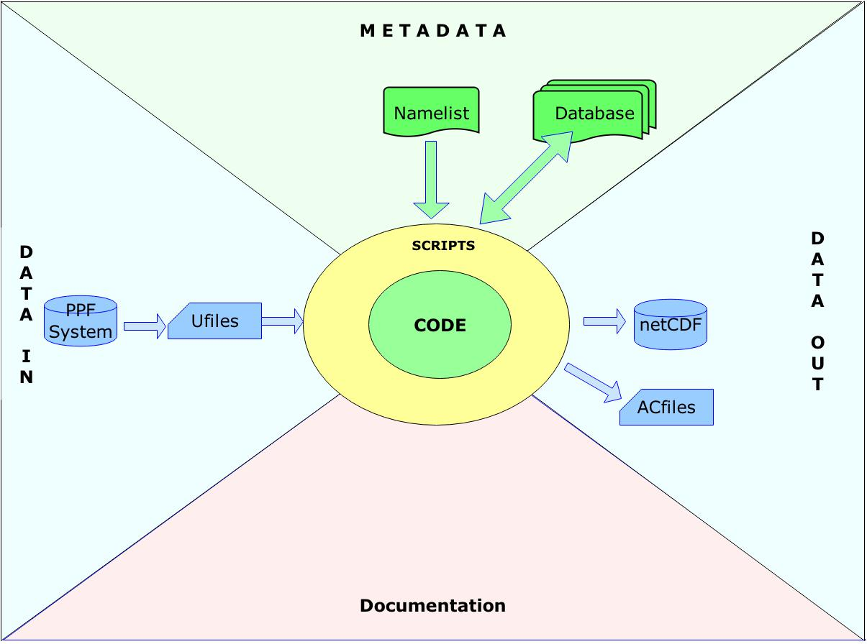
Transp - Environment

Slide 6
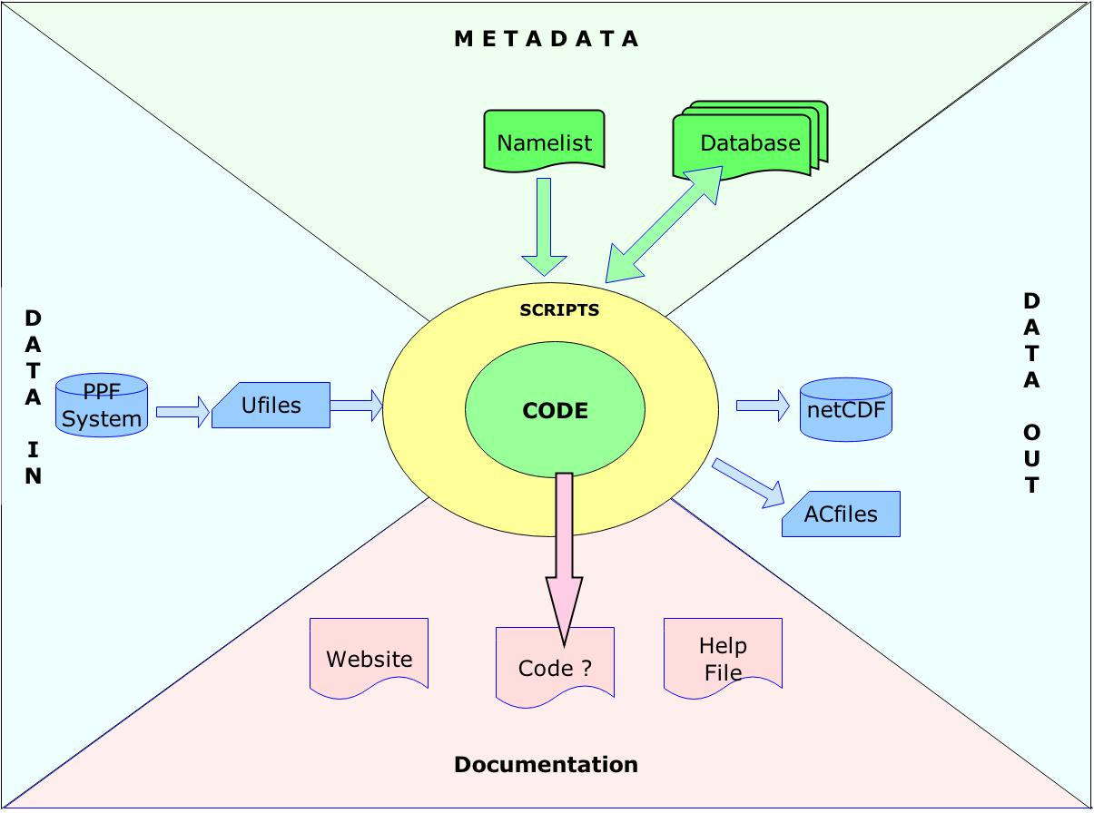
Transp - Environment

Slide 7
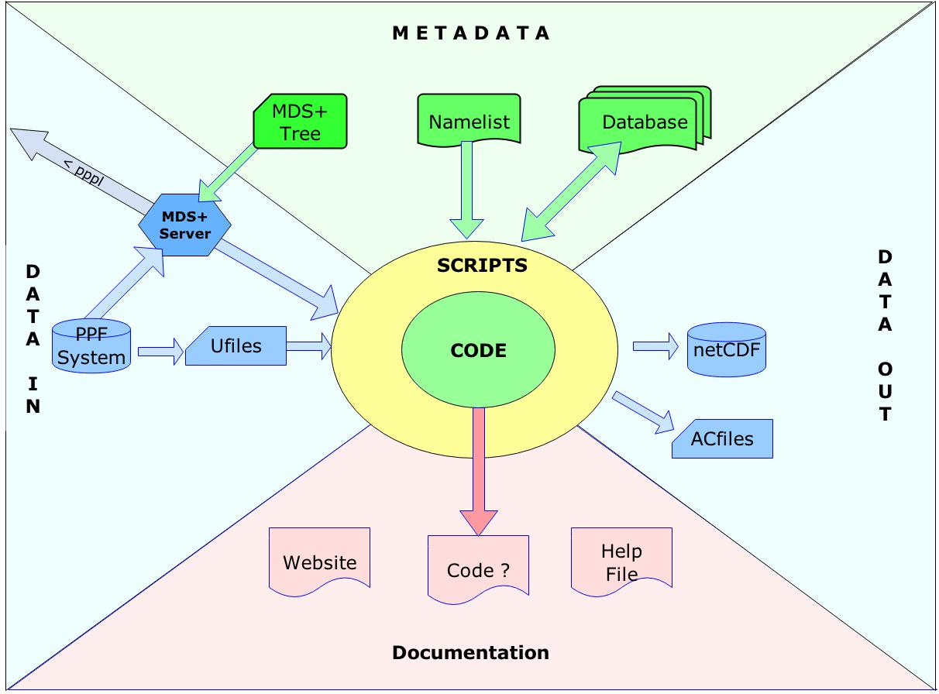
Transp - Environment

Slide 8
Transp Course 2014
Input Directories

Slide 9
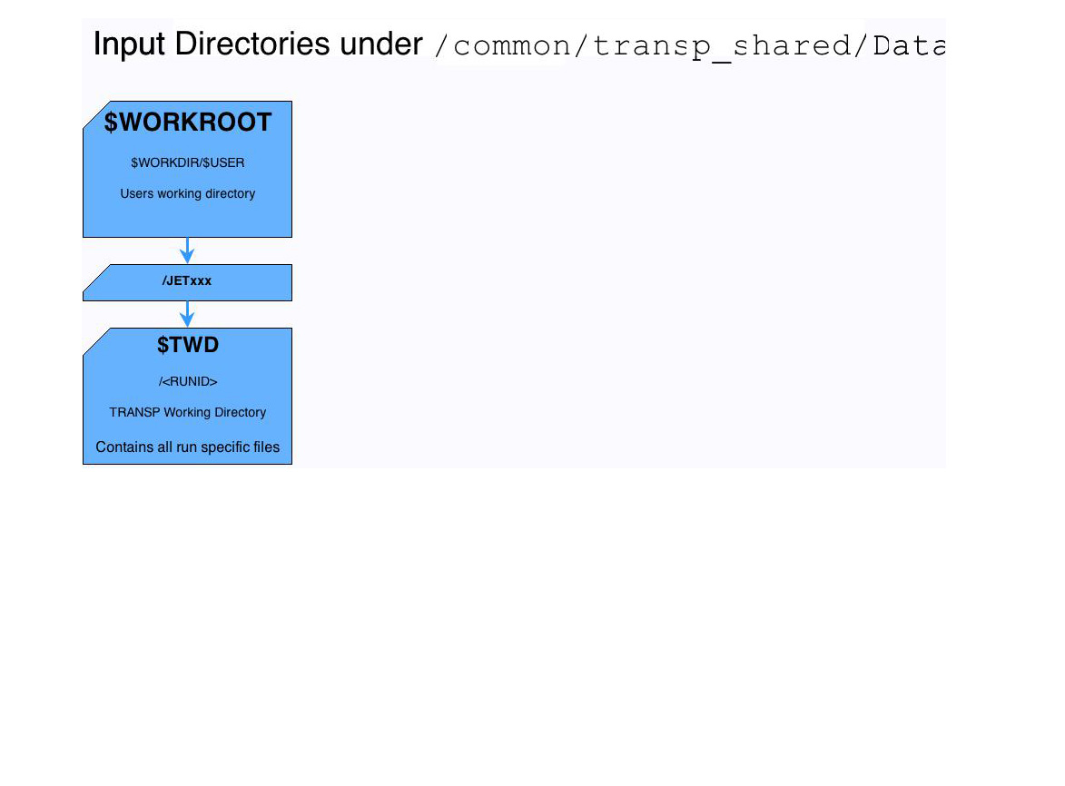
Transp Inputs

Slide 10
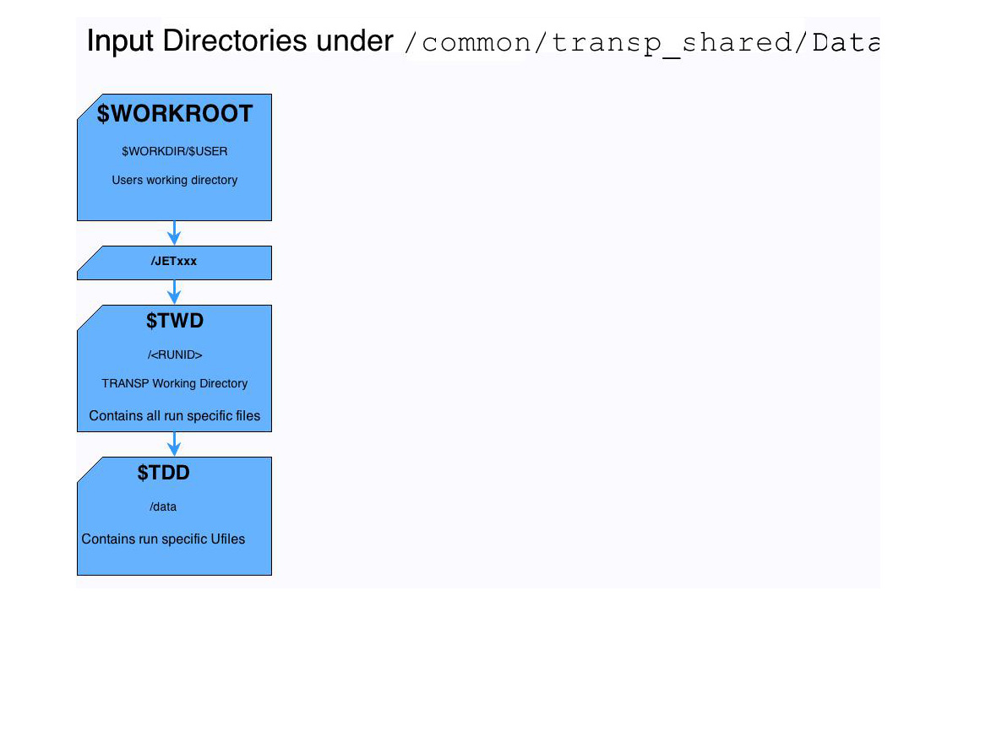
Transp Inputs

Slide 11
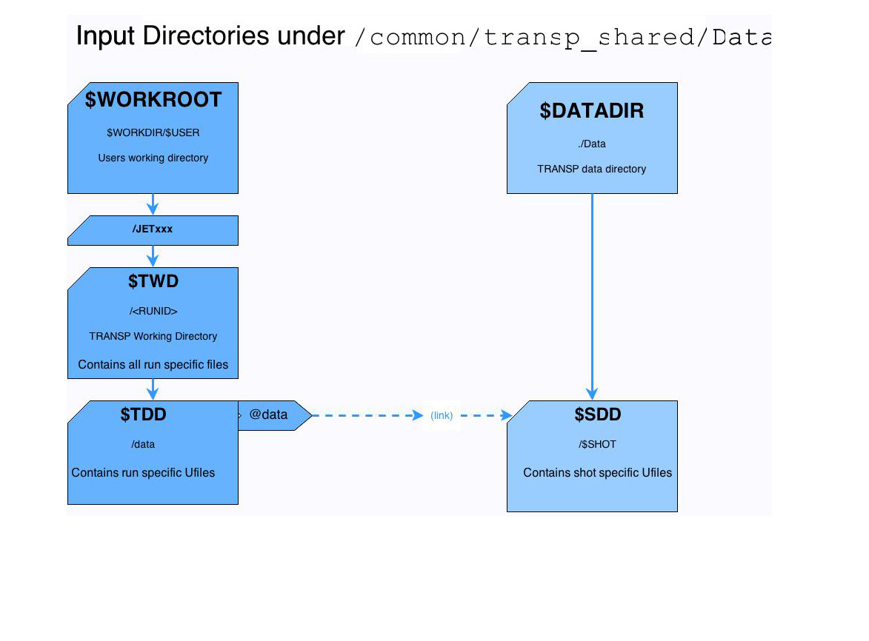
Transp Inputs

Slide 12
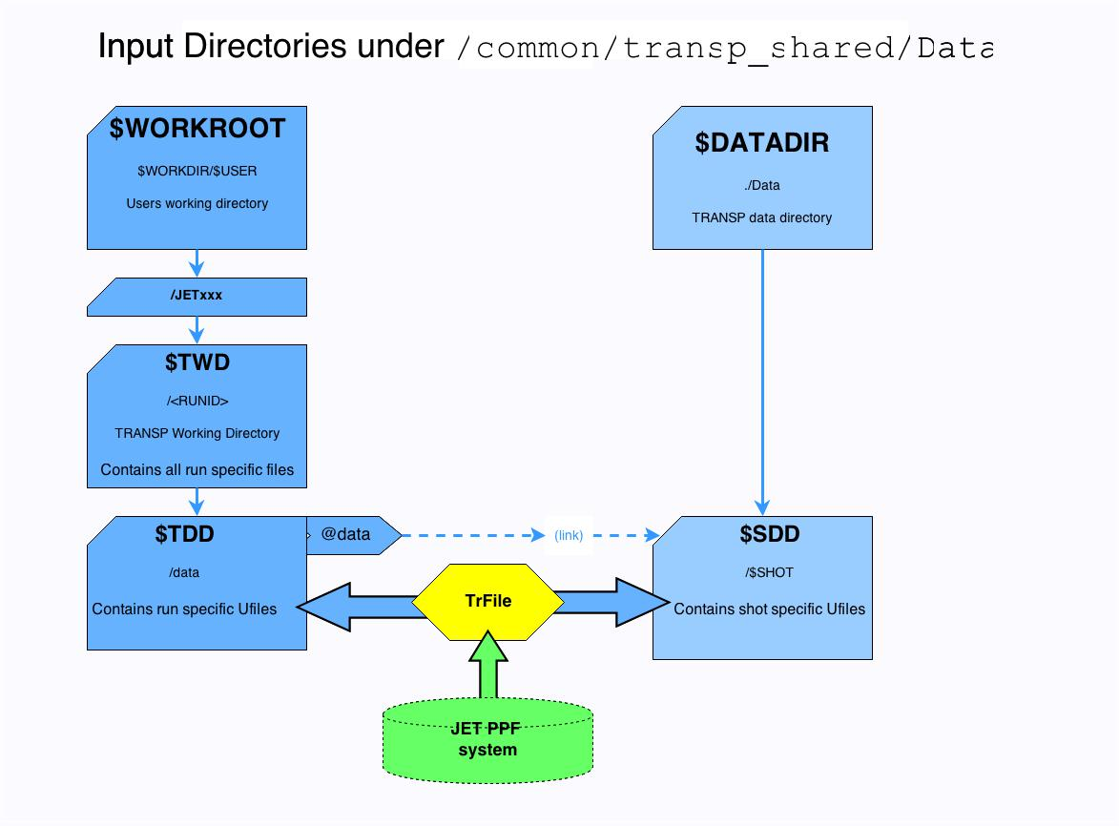
Transp Inputs

Slide 13
Transp Course 2014
Output Data

Slide 14
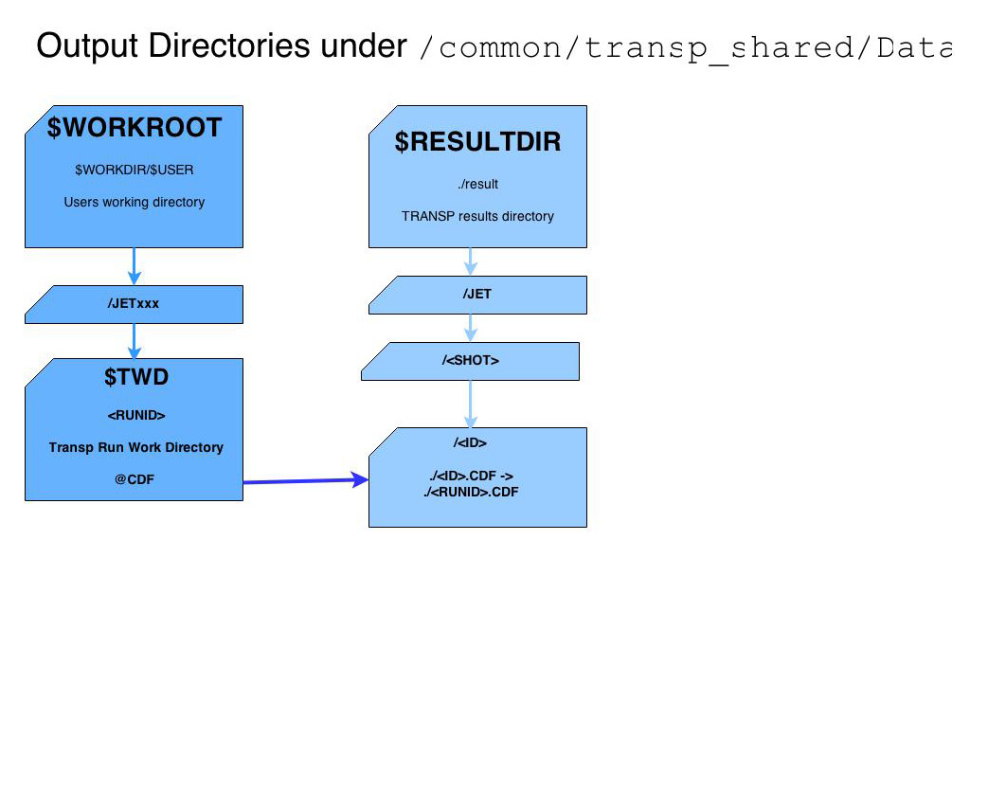
Transp Output Data

Slide 15
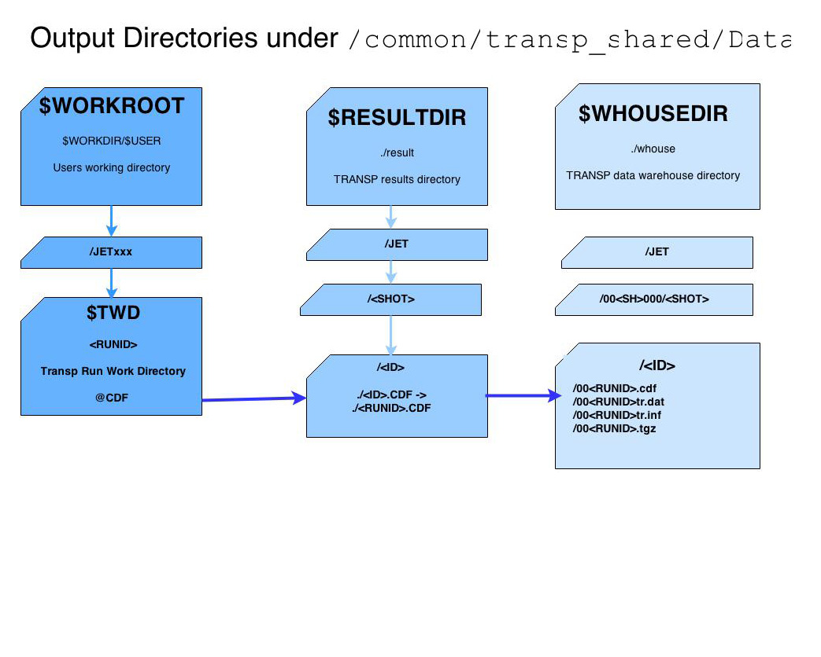
Transp Output Data

Slide 16
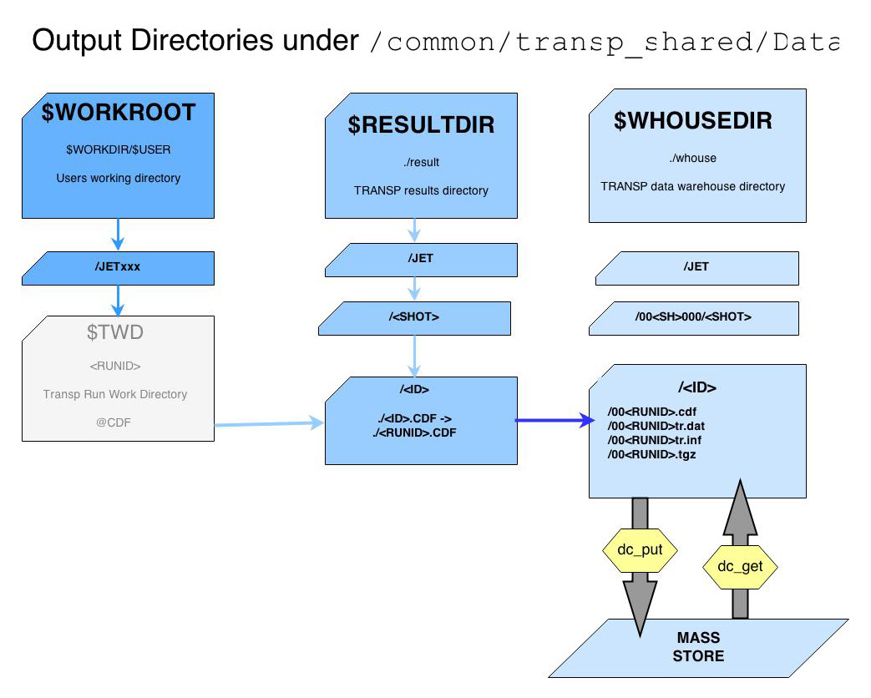
Transp Output Data

