Slide 1
Neutron Telescopes, Neutrons & Sawteeth
Transp User Course 2014 Jim Conboy

Slide 2
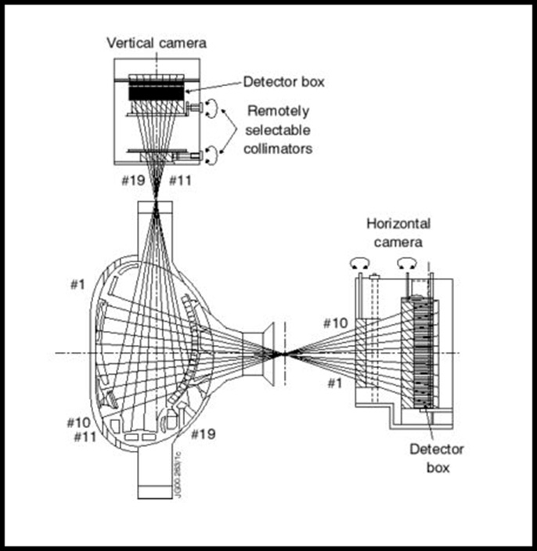
Neutron Telescopes
KNL3 – 10 Horizontal and 9 Vertical Collimated Neutron Telescopes (from “Prediction/modelling of the neutron emission from JET discharges” June 2001)

Slide 3
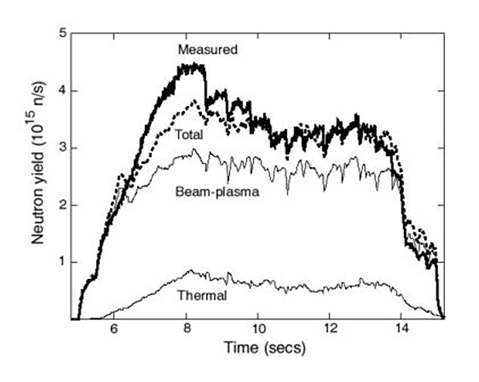
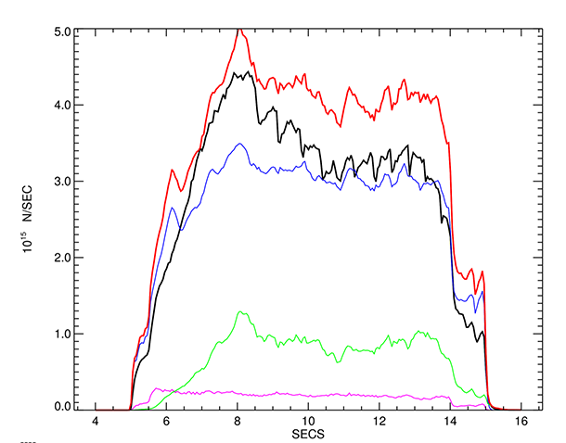
Neutron Rates
Shot 50623 – used for Neutron Rate calibration
Measured Neutron rates & NEPAM prediction
Transp Neutron Rate prediction – Total, B-Plasma,Thermal, B-B

Slide 4
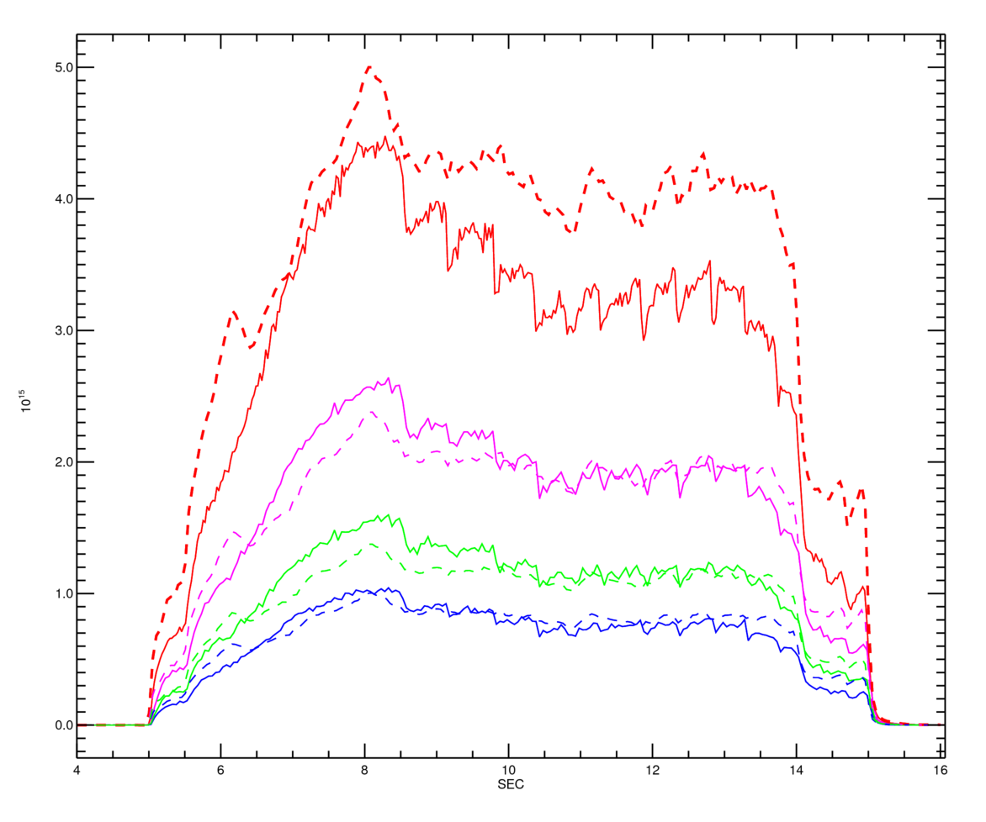
Neutron Rates
Shot 50623 – used for Neutron Rate calibration
Transp predictions (- - ) for Total neutrons & telescope sums – All, Horizontal, Vertical
Measured Neutron rates & NEPAM prediction

Slide 5
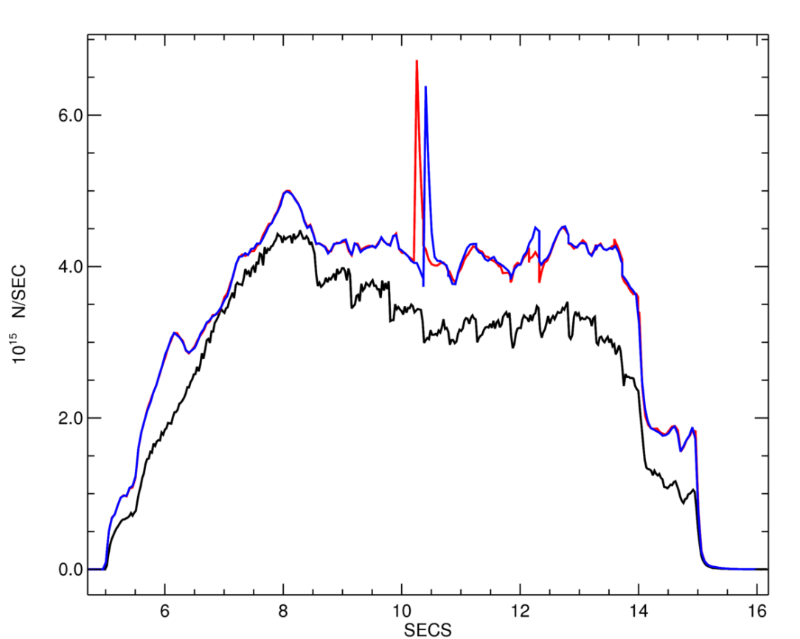
Sawtooth Models
Including a sawtooth model in Transp might reduce the total neutron rate, by mixing hot ions from the plasma core with lower energy ions at larger radius ?
Kadomtsev model: Runs J03,J04. Neutron spike follows 1st sawtooth time in both cases. Not quite physical ?

Slide 6
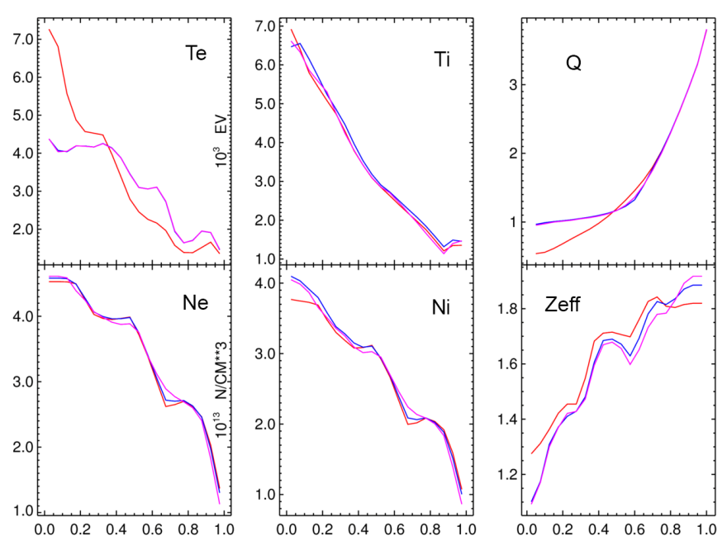
Sawtooth – Kad. model
Plasma profiles before (red) & after the 1st sawtooth; Q(0) > 1. is the KM constraint; T_{e}(0) is halved

Slide 7
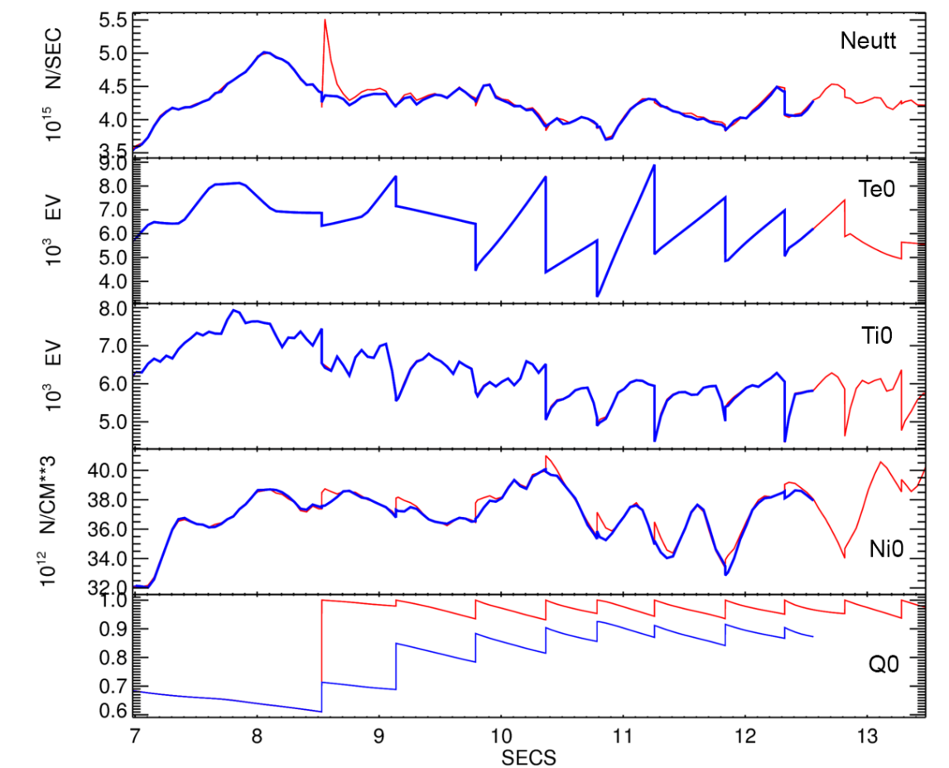
Sawtooth – Kad. & Por. models
Plasma axis variables, J05 (Kad.) & J06 (Por).; ‘Island width’ parameter 0.5 no change to total neutrons – except the unphysical spikee

Slide 8
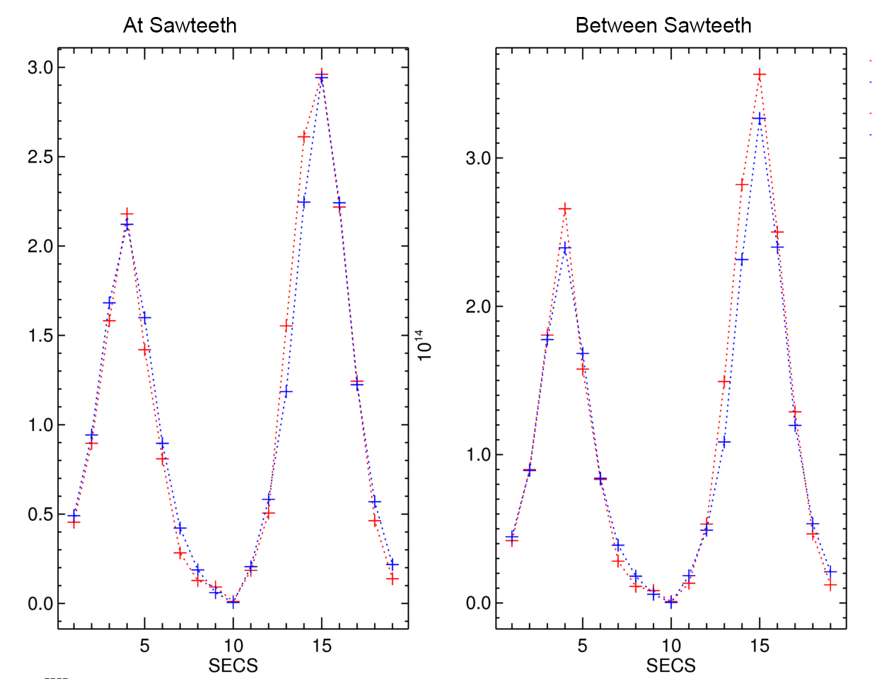
Telescope profiles
Telescope Profiles for data & J06 (Porcelli, Fp=0.5), averaged over 5 timepoints.

Slide 9
Telescope ‘Centrality’:
Statistics on individual telescopes are challenging, so define ‘Centrality’ C_{x} = Peak/All, for vertical, horizontal & all T/s :-
(Can be calculated in jetdsp – form cumulative integral over telescope axis)

Slide 10
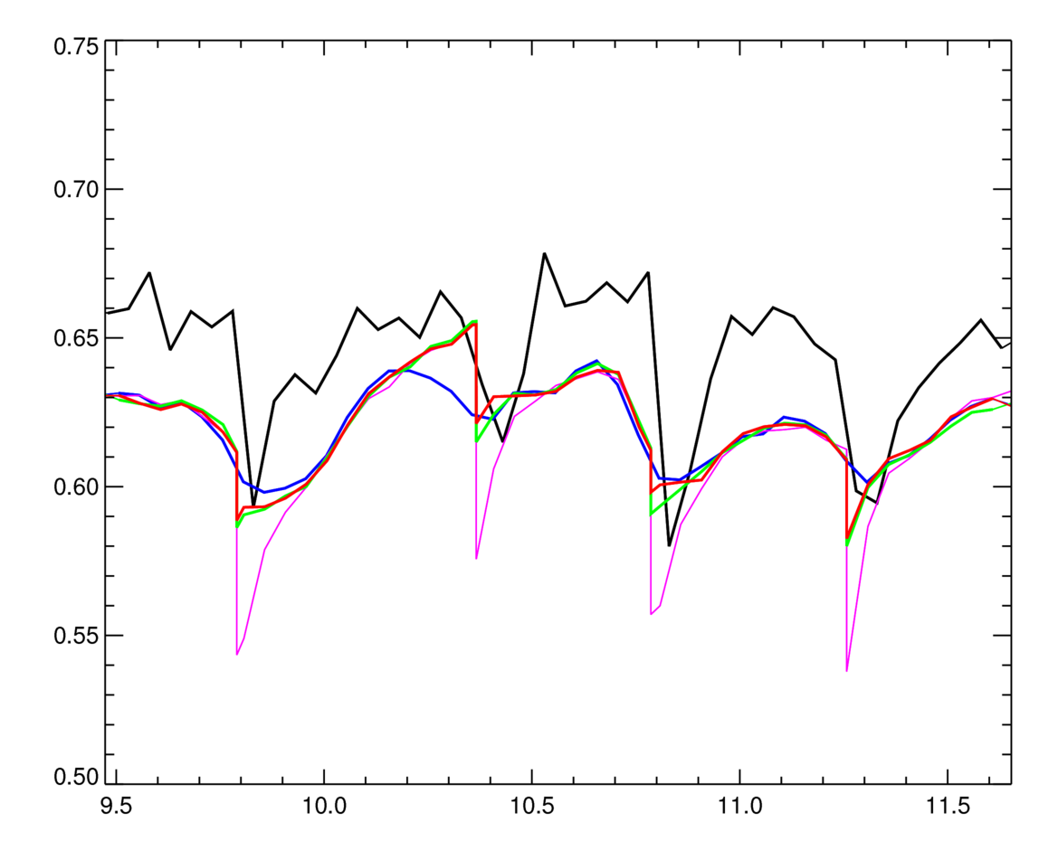
Centrality & Sawteeth
‘Centrality’ for all telescopes
The data is more central than any Transp run, both at and between the sawteeth
Transp shows some sawtooth structure, even if no sawtooth model is invoked (run J02)
The Kadomtsev model gives a sawtooth behaviour of comparable magnitude to the data
The Porcelli model produces smaller sawtooth, and is not very sensitive to the island size parameter (F_{p}).
All Transp runs give a similar telescope profile between sawteeth

Slide 11
Conclusions
Total Neutron flux predictions remain a problem
Neutron Telescope rates are reproduced quite well
Neither Sawtooth model helps the Neutron predictions (between sawteeth)
Kadomtsev model reproduces the telescope ratios better, but introduces artifacts in the total neutron distribution
Porcelli model doesn’t reproduce the telescope ratios as well as Kadomtsev
( Based on a limited number of runs, on a single shot. Altering other settings may improve the results )

