Slide 1
RF codes for Transp
Transp User Course 2014 Jim Conboy

Slide 2
RF codes
JET RF heating (ICRH) is provided by
Four A2 Antenna
Two ‘Iter Like’ antenna ( for C22-24? only, & if you are lucky)
Transp offers two RF heating codes –
Spruce
Old
Not very accurate
No longer supported (but works ..)
Fast !
Toric
Fairly recent (Vn 5)
Accurate – benchmarked against AORSA
Slow, even with many processors

Slide 3
RF Heating - Options
To add RF heating to a Transp run, need some details –
Which Antenna are active
What phasing was used
Options –
Choice of RF code
To combine Antenna with same phasing & similar frequency
To add more Nphi (Torroidal mode number) values
Change grid sizes etc (not advisable)

Slide 4
RF Codes – FPP/Spruce
FPP/SPRUCE is a package for comprehensive simulation of Neutral Beam Injection (NBI) and Ion Cyclotron Radio Frequency (ICRF) heating of tokamak plasmas.
FPP solves the bounce-averaged Fokker-Planck equation to find the fast ion distribution function f(E,mu,r,t), as a function of energy E, magnetic moment mu, minor radius r and time t. It includes the bounce-averaged quasilinear RF heating operator and radial transport models as well as the collisional thermalization operator.
The resulting 3-D Fokker-Planck equation (i.e., a convection-diffusion equation in 1 radial and 2 velocity dimensions) is solved using a conservatively-differenced operator-splitting technique (similar to the ADI algorithm).

Slide 5
RF Codes - Spruce
SPRUCE solves a 3D wave equation (NOT ray-tracing) for the ICRF fast wave. It calculates the propagation, focussing, diffraction, and damping of the fast wave including the effects of fundamental and second harmonic ion damping, electron damping, and mode conversion.
The power mode-converted to the Bernstein wave is estimated using an order-reduction scheme. The calculation can be summed over kz's to obtain a fully 3-D solution, although at the moment we use only a single dominant kz.
Spruce is no longer supported

Slide 6
RF Codes - Toric

Slide 7
RF Codes - Toric

Slide 8
RF Codes - Toric

Slide 9
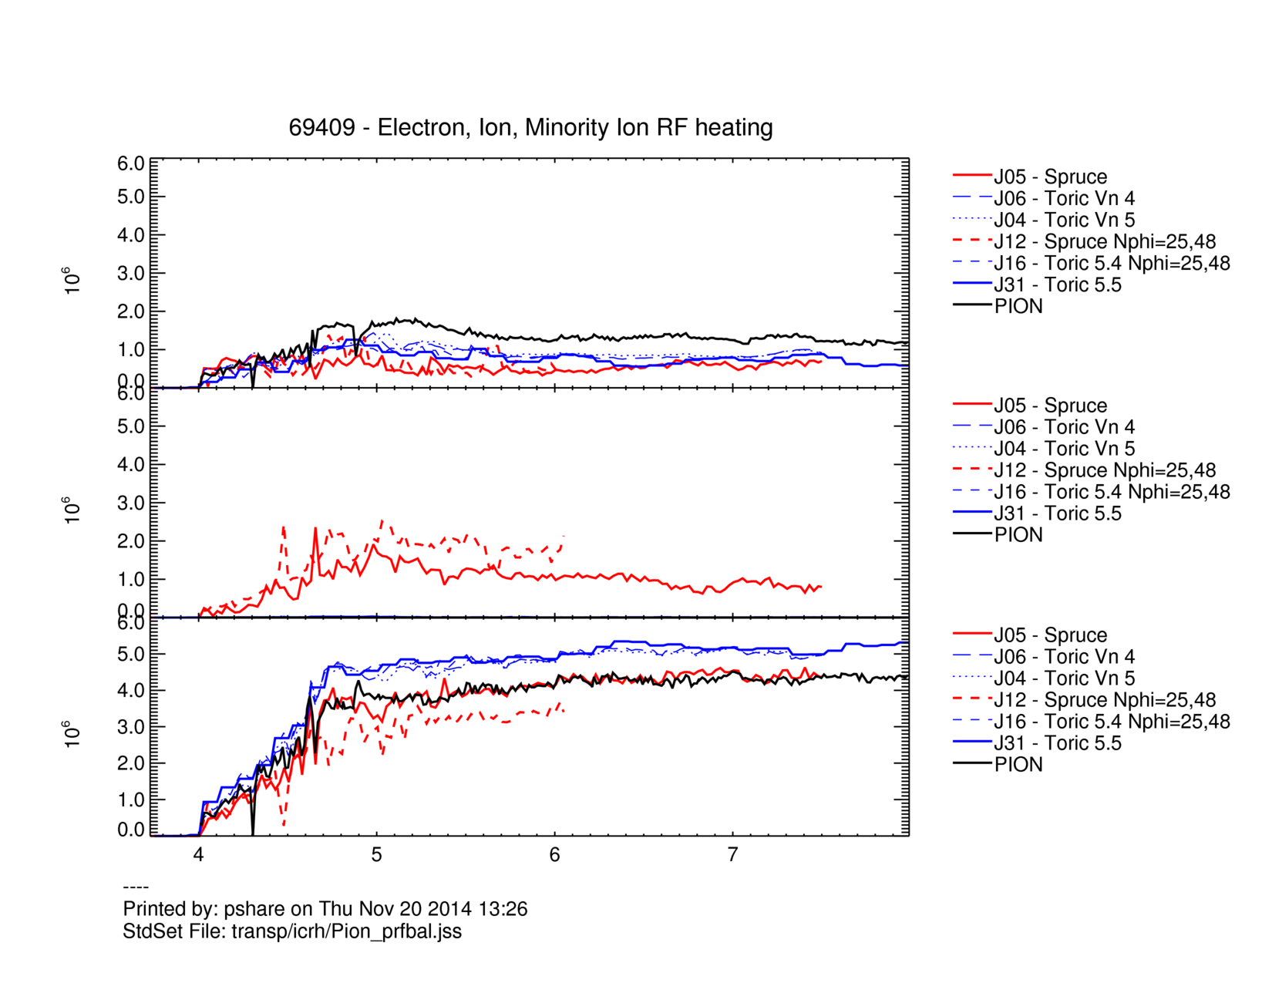
e
Ion (?)
Min. Ion

Slide 10
Comparison of Codes
Spruce –
Ion Heating ??
Significant change, adding 2nd Nphi value
Agrees with Pion ( for minority heating)
Toric –
Good agreement between different versions
~ 20% variations (in power deposition) between codes
Power deposited is constrained to equal input power (by Transp … )

Slide 11
Comparison of Codes II
Radial Power deposition – e⁻ & I_{min}

Slide 12
Spruce – (In)consistency
ILA commissioning - Spruce – Minority Ion profile, 128 & 256 zones & Toric

Slide 13
TkToric (plotting package)
Toric can generate some pretty plots …

Slide 14
Summary
If ICRH heating is small, or not a major concern – use Spruce
For shots where ICRF is a significant (or the only) heating, use Toric (with NMOD=63, default)
The ICRH directory (which contains the Transp-Toric interface files) is saved at times specified on OUTTIM card. Stand alone Toric can be run with higher resolution using this saved data.
Further Reading –
Toric web pages (linked from JET Transp site)
Shots 74091/93/94 (Antenna phasing); 74598 (ILA); 69409J16 – 2 Torroidal modes

